Slide 1
Optimization and Cost Function with Gradient Descent
By… Sakeeb Sheikh

Slide 2
Optimization
Evaluation is essentially how you judge or prefer one model vs. another
It’s what you might have seen as a cost function, utility function, loss function, scoring function, or fitness function in other contexts.

Slide 3
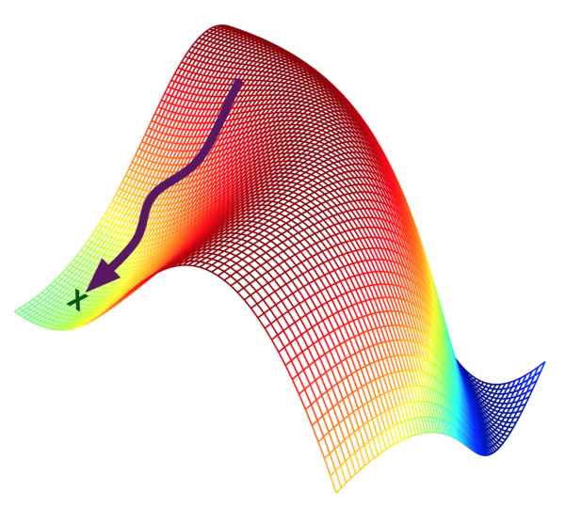
Optimization
Optimization is how you search the space of
represented models to obtain better evaluations.
This is the way you expect to traverse the
landscape to find the promised land of ideal models;
the strategy of getting to where you want to go.
To optimize the model different techniques are use
and gradient descent is one of them

Slide 4
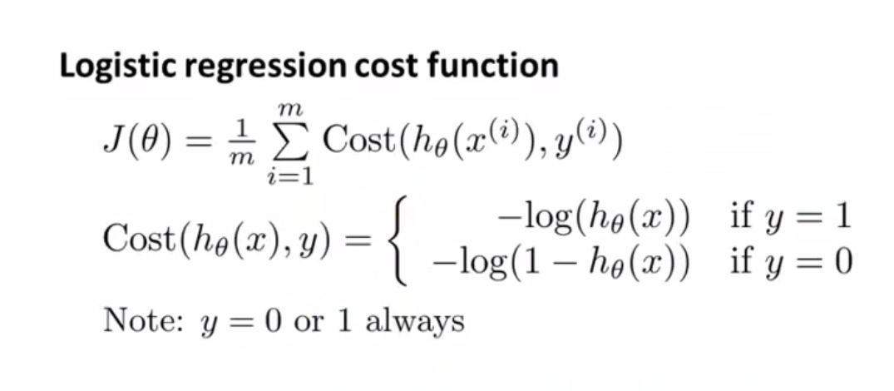
Example

Slide 5
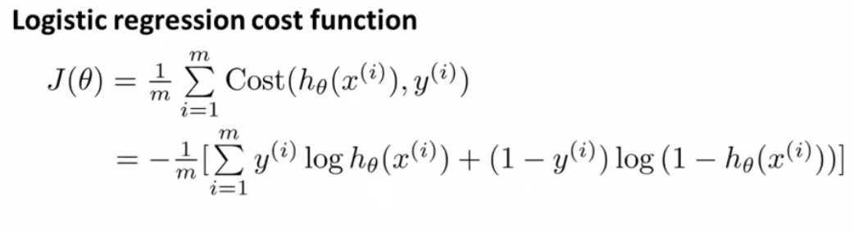

Slide 6
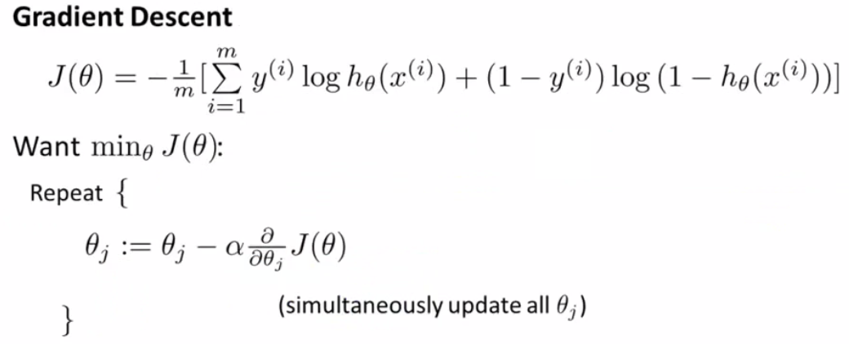
Min of Cost function
Derivative of ϴ
Gradient function

Slide 7
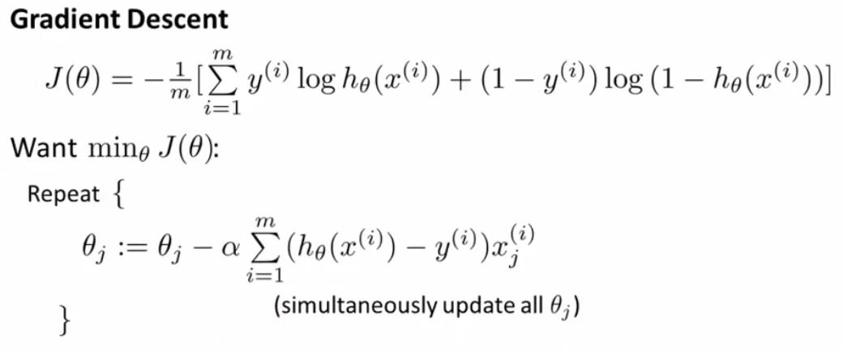

Slide 8
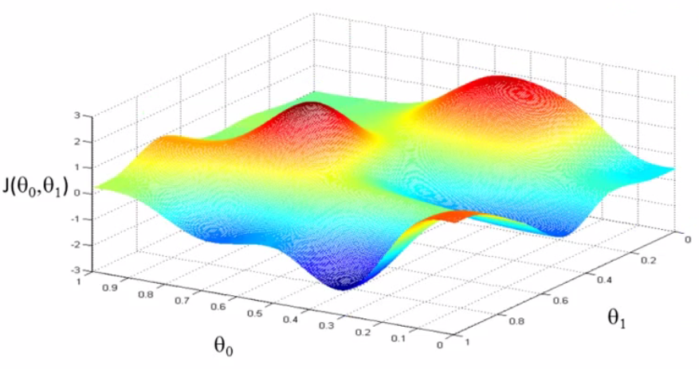
Gradient Descent – hill example

Slide 9
Initialize gradient descent at given place

Slide 18
If Initialize gradient descent at other given place

Slide 20
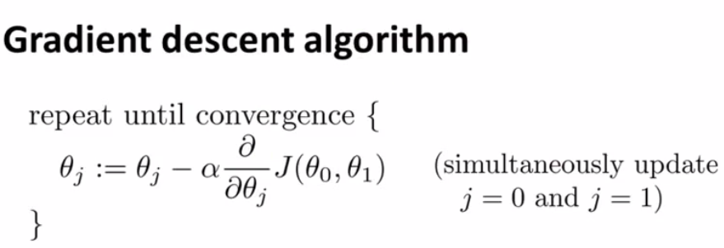

Slide 21
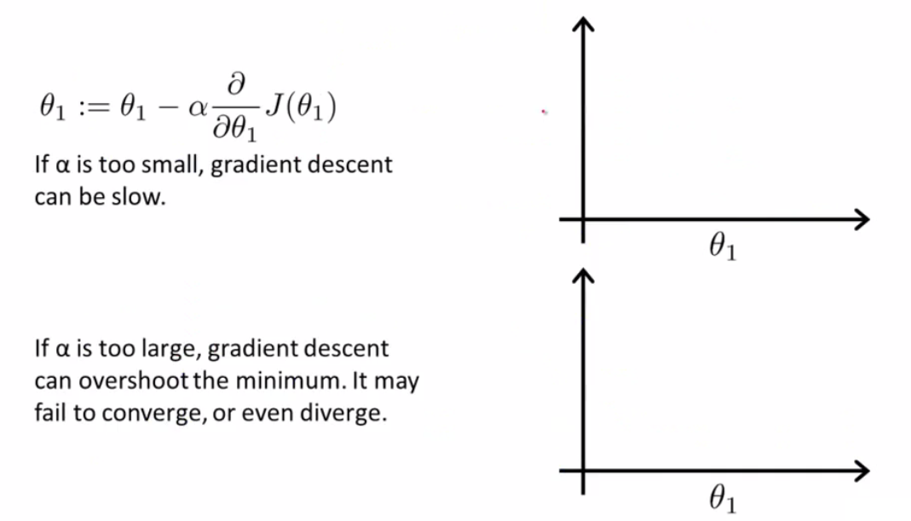

Slide 22
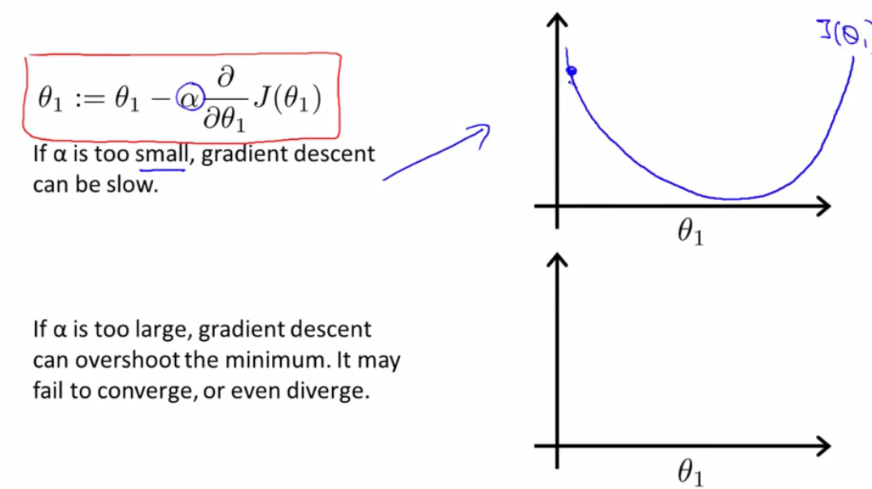

Slide 23
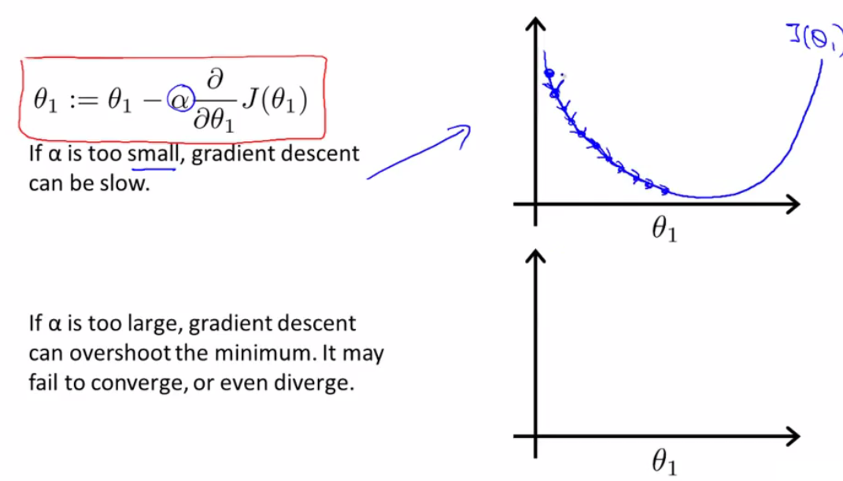

Slide 24
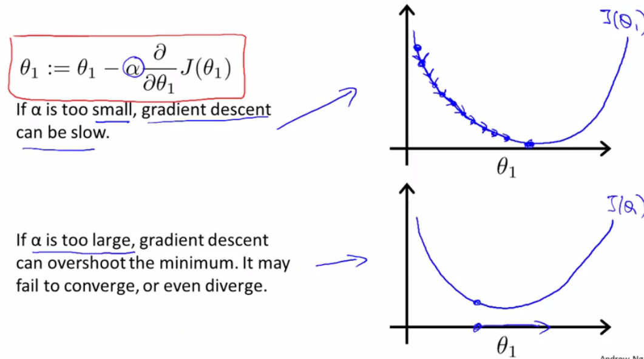

Slide 25
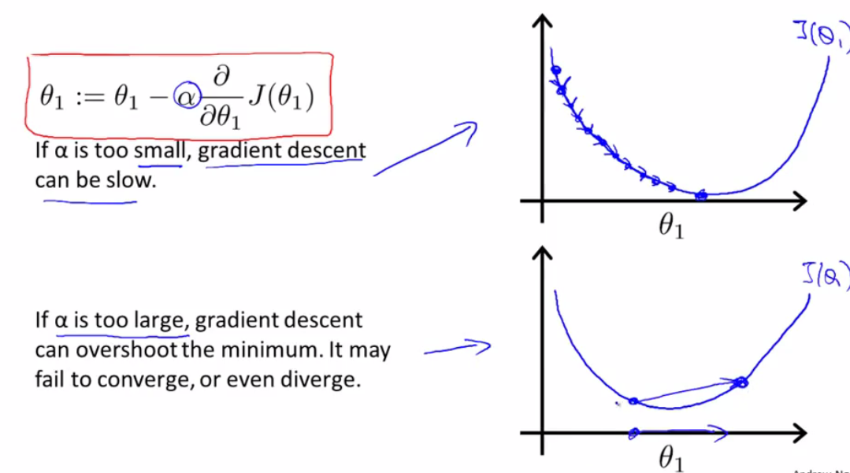

Slide 26
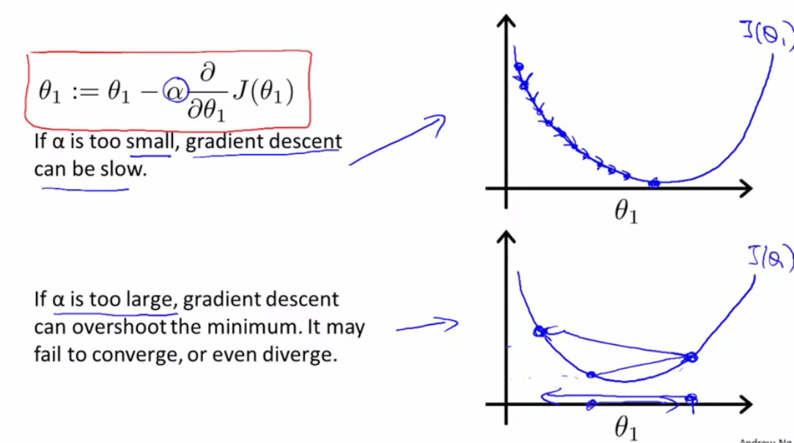

Slide 27
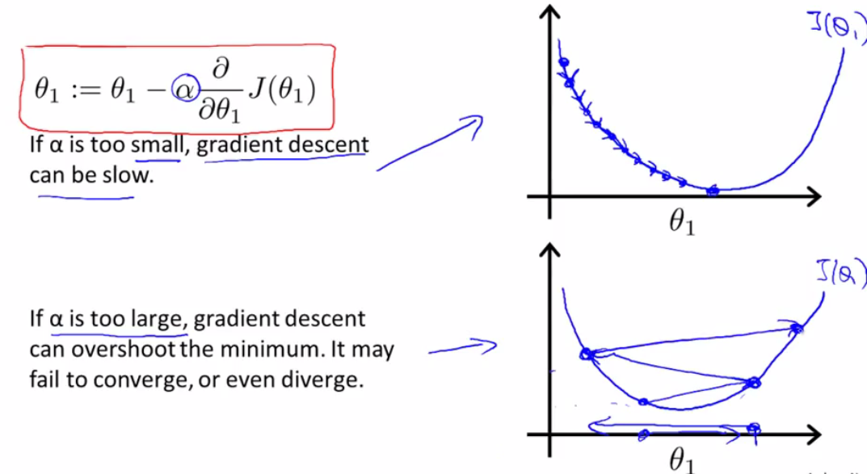

Slide 28
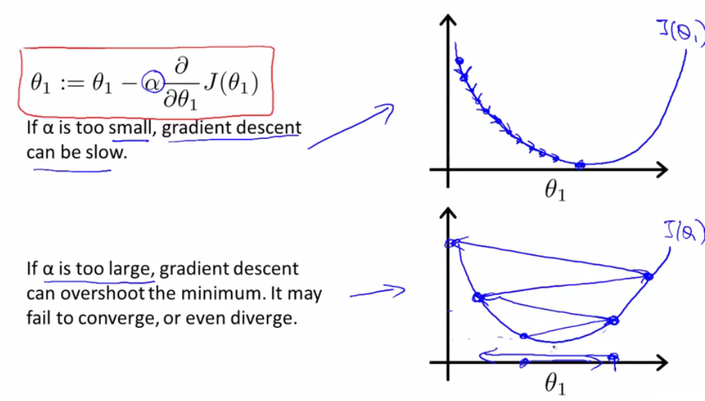

Slide 29
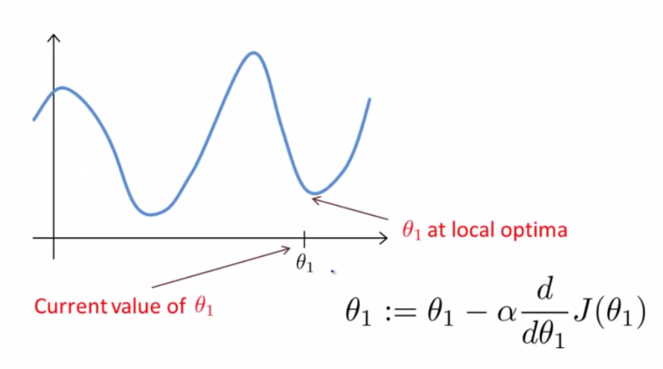

Slide 30
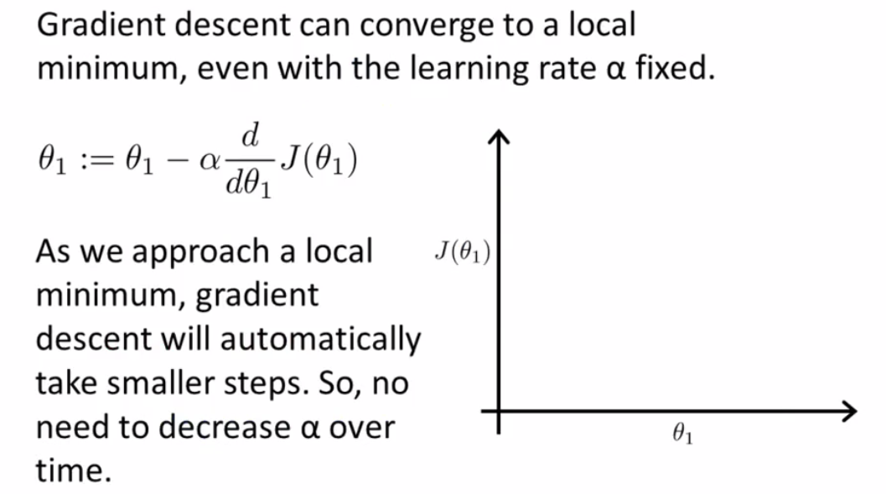

Slide 31
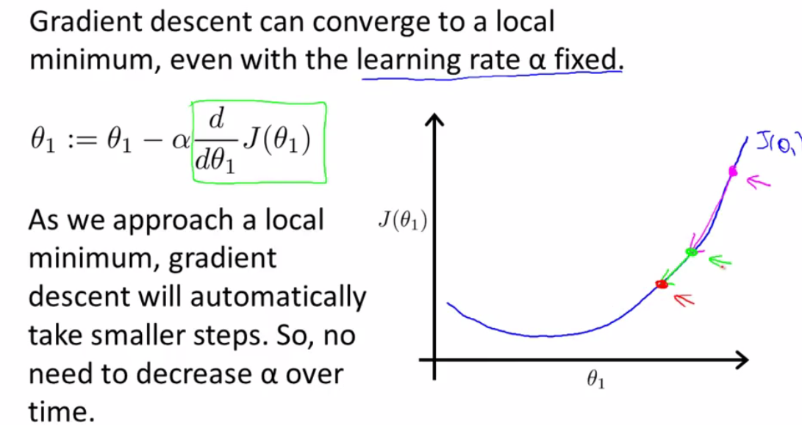

Slide 32
